Slide 1
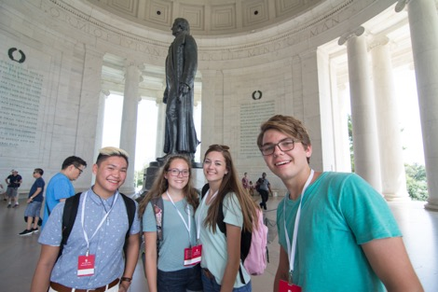
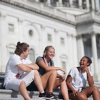
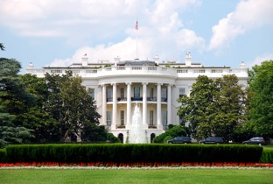
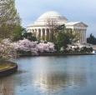
Ms. Golledge’s Washington, D.C. Trip

Slide 2
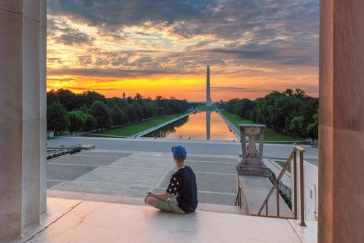
In This Meeting…
01
Our Trip and all that we’re going to see and do
02
What’s Included in our travel program
03
Our Travel Partner WorldStrides and why we are so excited to work with them
04
How to Sign Up for this incredible opportunity

Slide 3
A Trip You’ll Remember for Years to Come
Your source for info about the additional Covid-19 related health & safety measures that will be in place for your trip.

Slide 5
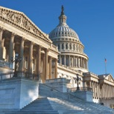
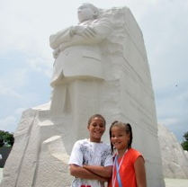
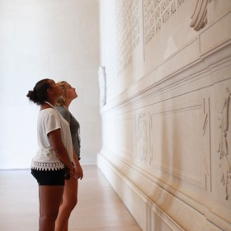
Our Trip Includes
Hotel Accommodations
Transportation to & from our destination, and throughout the trip
Meals
Attractions & Activities
Course Leader
Academic Credit
Discovery Journals
Safety and Support
Now for the fun part…let’s look at everything we’re going to do and see!
Notes:
So let’s talk about the specific details of our trip.
<<PL mentions the trip information letter that they have already shared with the families. They’ll review the highlights of the trip and mention a few of the sights that they’re looking forward to the most. They’ll end by saying how they’ll continue to work with WorldStrides over the coming months to finalize the exact itinerary – one that maximizes fun with learning. If PL has photos from prior trips and wants to show, they can, otherwise that travel photo slide can be deleted>>

Slide 6
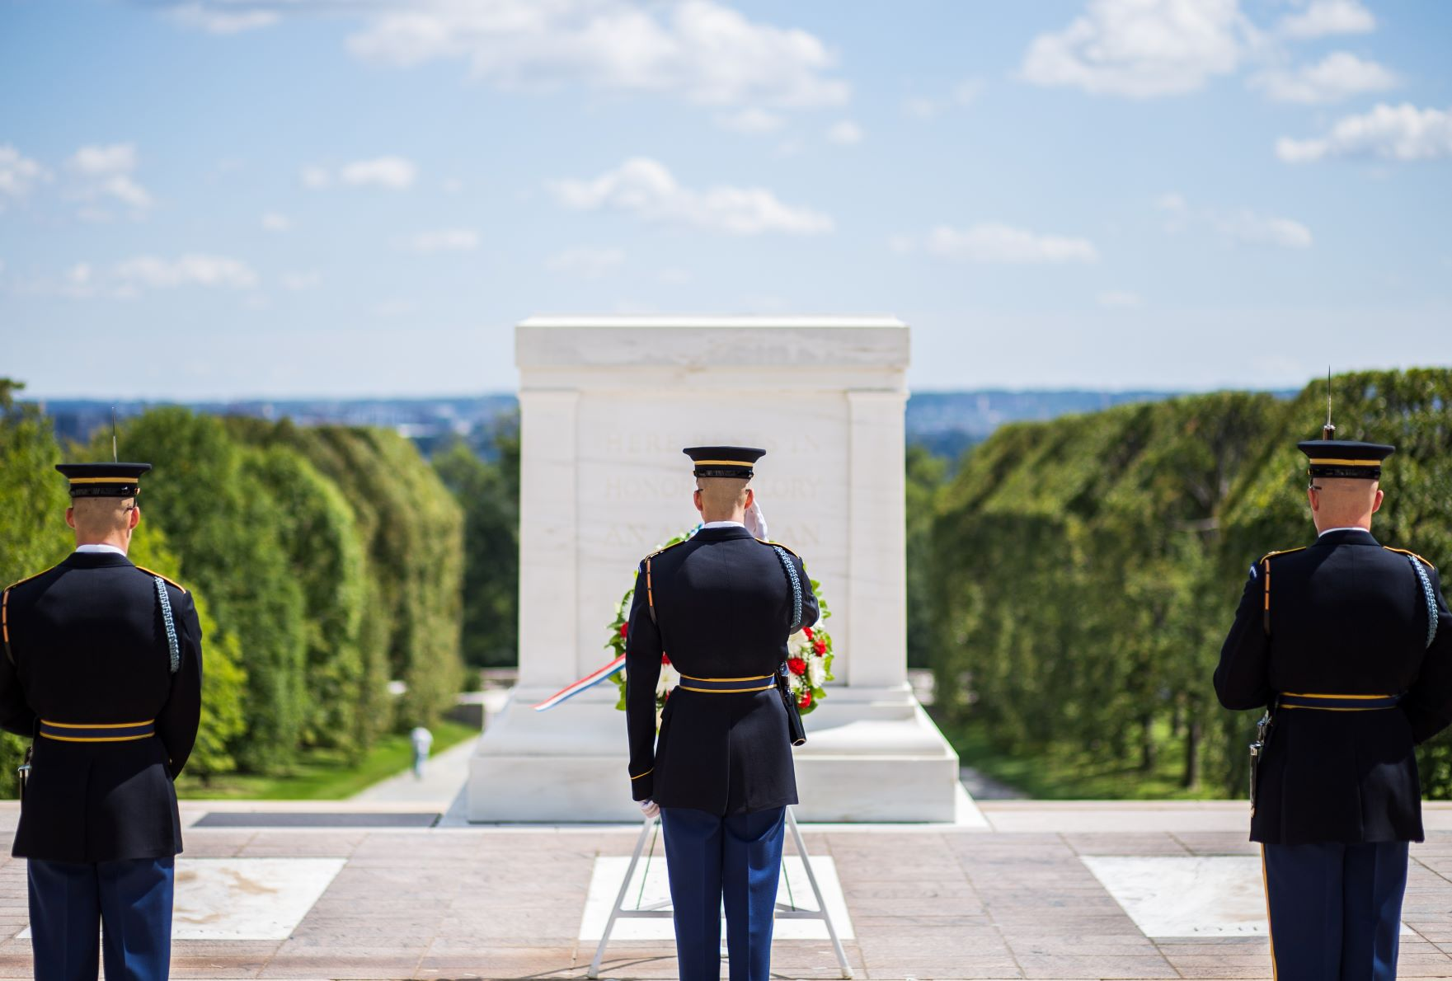
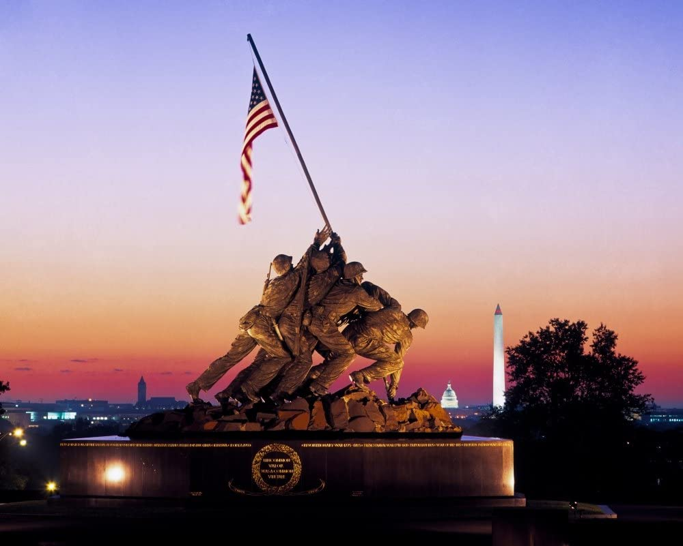
Tomb of the Unknown Soldier
Marine Corps Memorial
Arlington National Cemetery

Slide 7
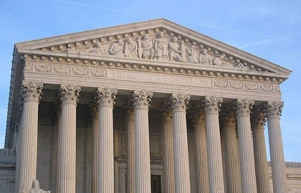
United States Capitol. Supreme Court. Library of Congress.

Slide 8
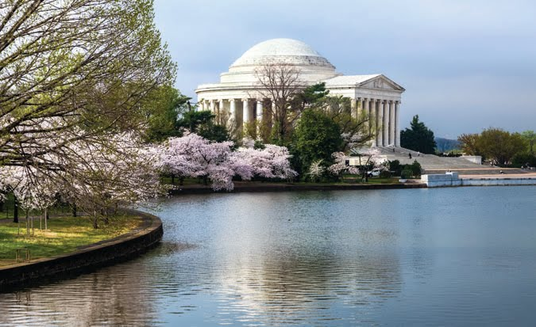
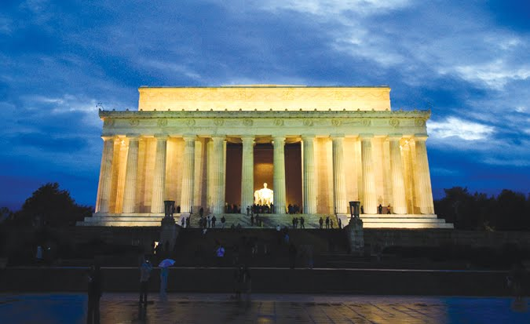
Jefferson Memorial
Martin Luther King Jr Memorial
Lincoln Memorial

Slide 9
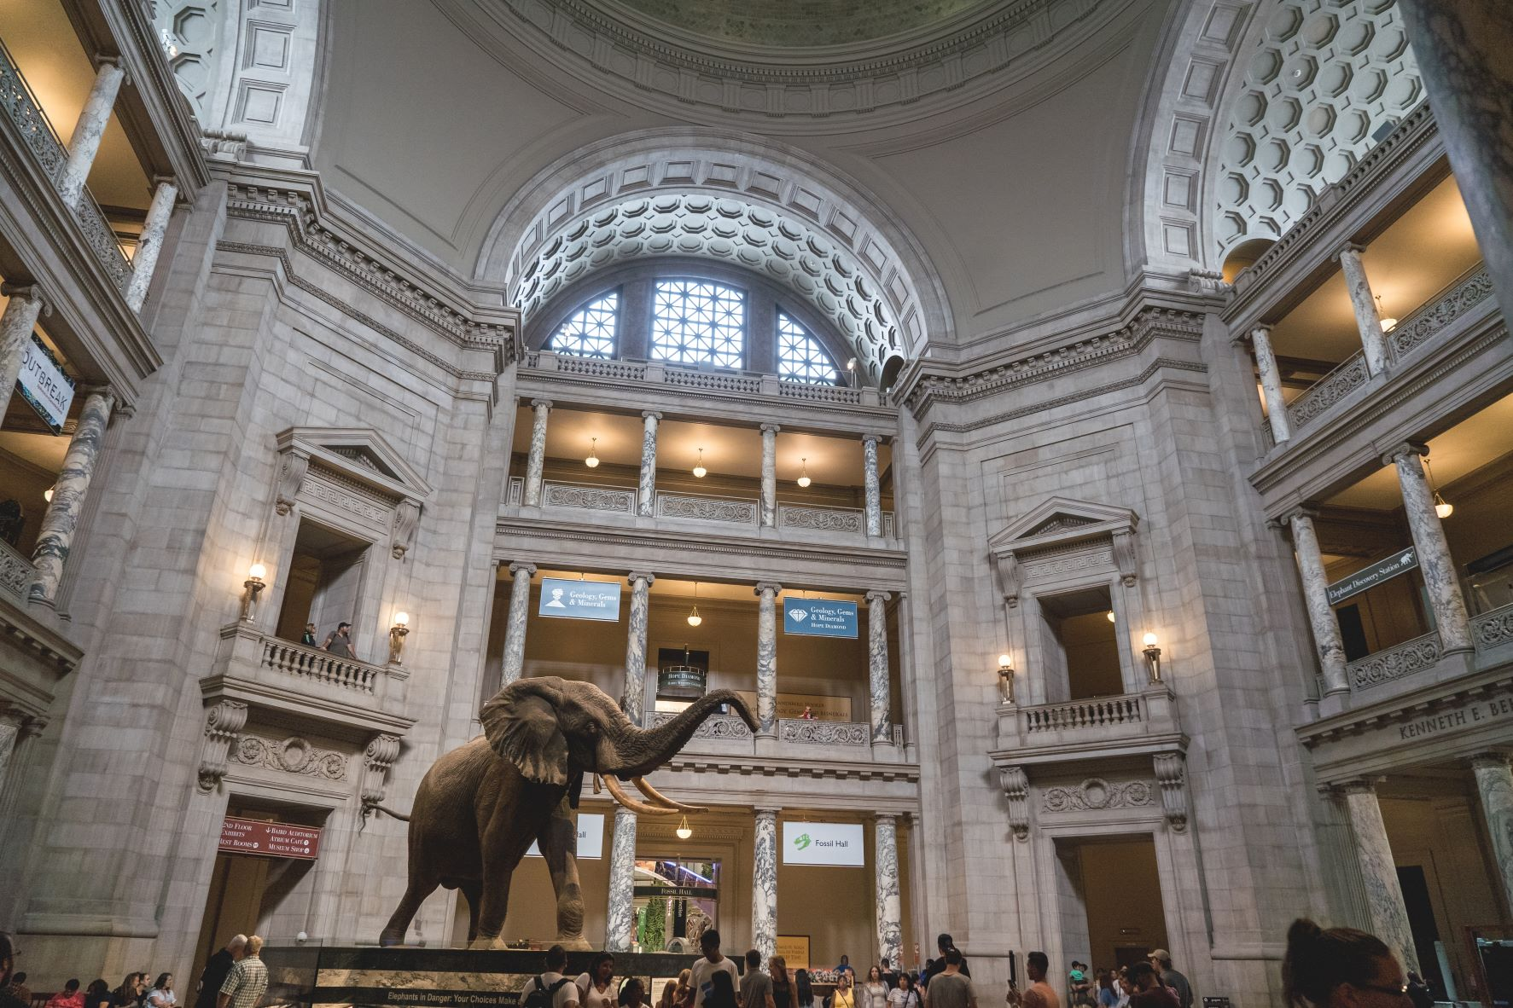
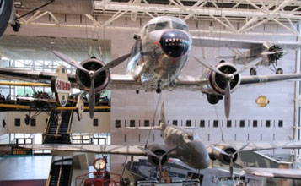
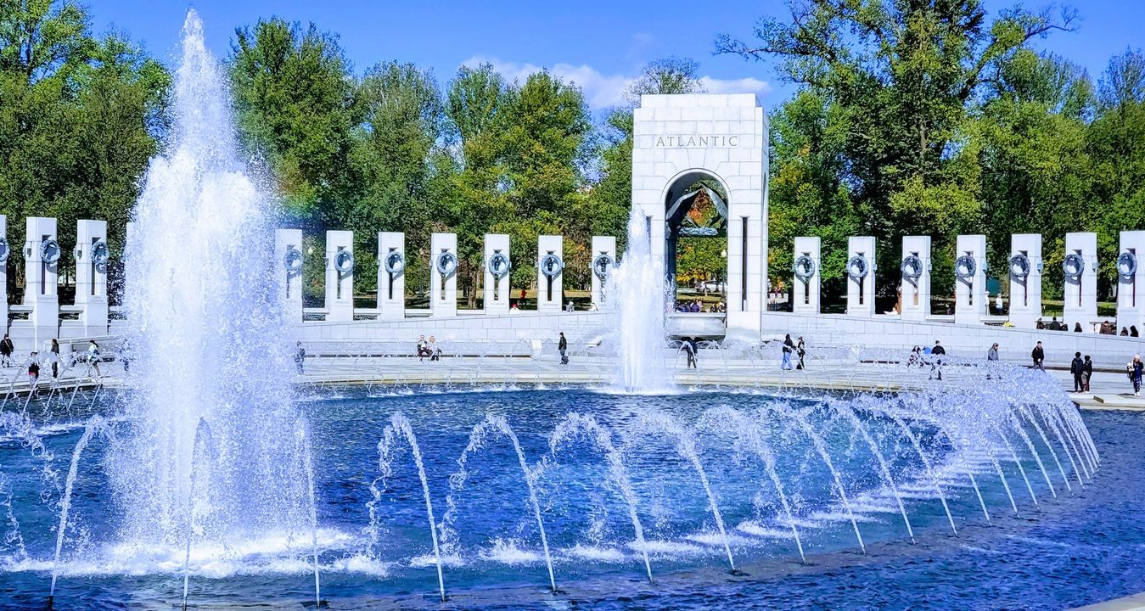
World War II Memorial
Smithsonian Museums

Slide 10
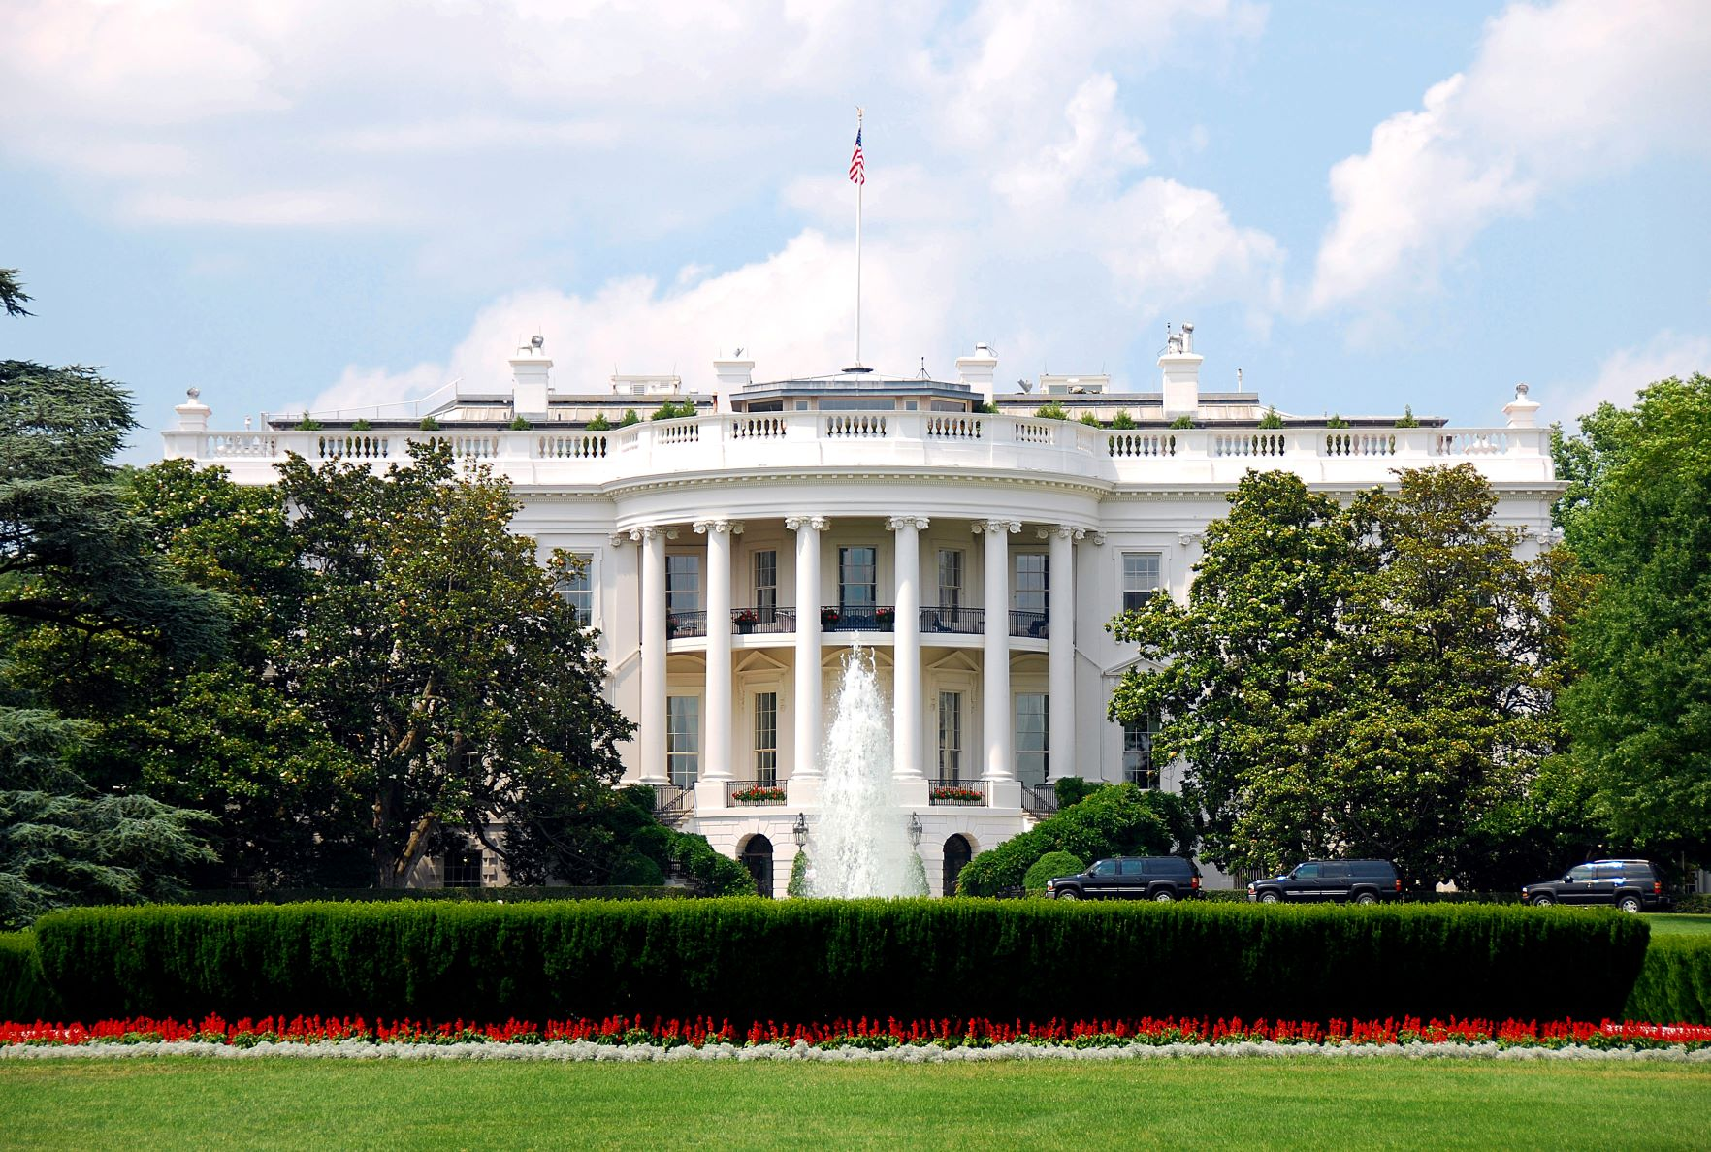
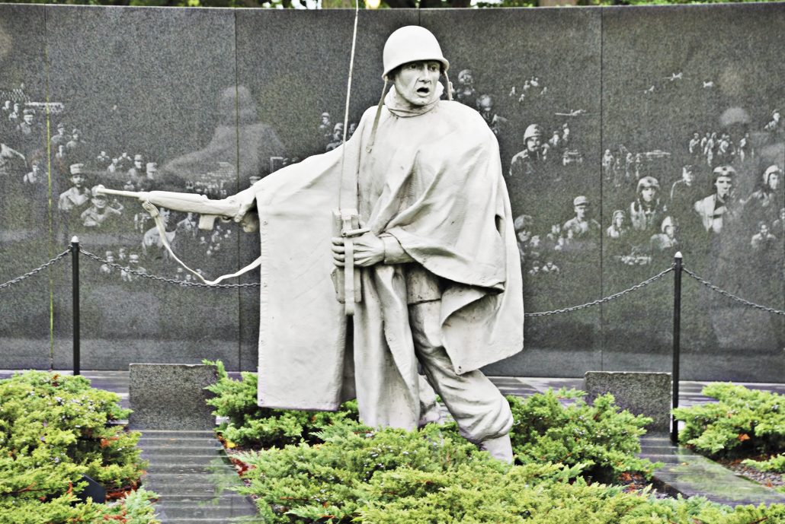
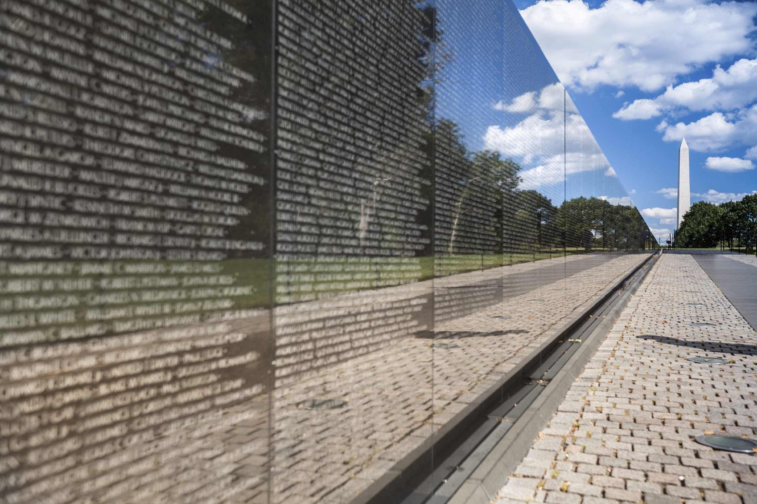
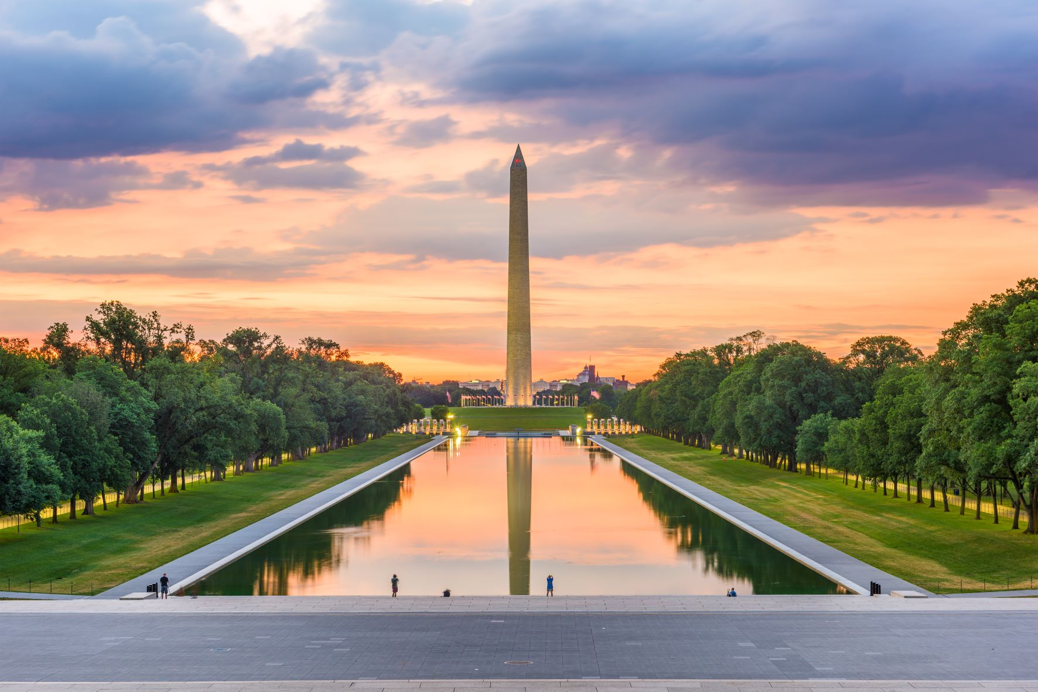
White House
Korean War Memorial
Vietnam Veterans Memorial
Washington Monument

Slide 11
Our Trip Details
Trip Dates: May 1st – May 4th, 2023 Price: $1,999 equired to secure your spot!
Our Registration Deadline is: January 31st, 2023
Trip ID: 202060
Full Refund Protection Plan: $239
Provides a full refund of all monies paid to WorldStrides (minus the cost of the FRP program) should you have to cancel for any reason.

Slide 12
Thank You for Attending!
Sign up TONIGHT! Our Trip ID is 202060
Online: worldstrides.com/register
Phone: 800-468-5899
Questions? Email leannegolledge@gmail.com
We can’t wait to see you all in Washington, D.C.!

